Slide 1
What will wait for you in MEE?
Nguyen Thu Hoai – MEE3 – 03/09/2019

Slide 2
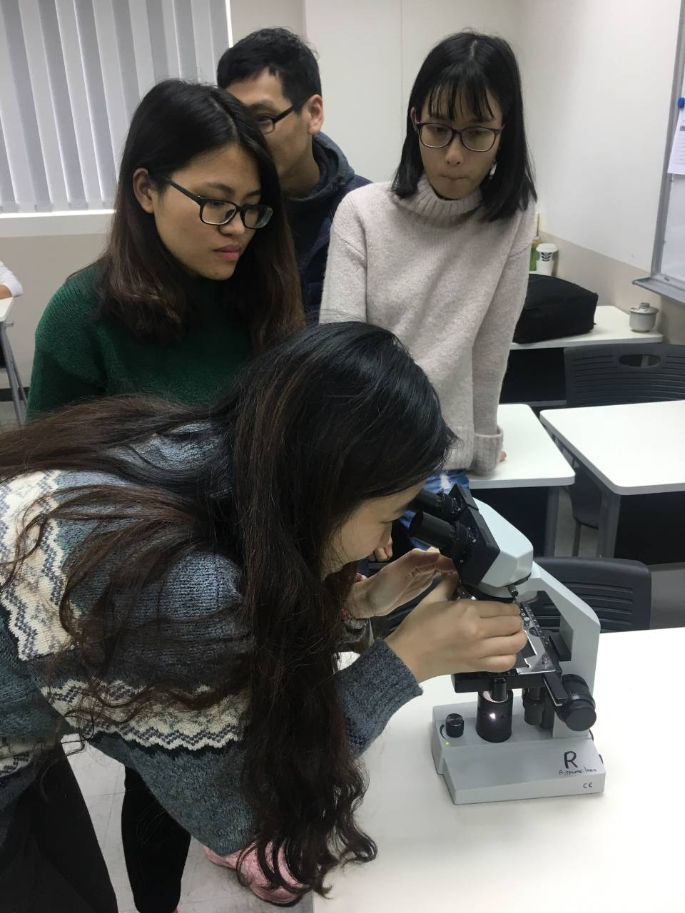
WHAT IS MEE?
MASTER OF ENVIRONMENTAL ENGINEERING
Physical
Chemical
Biological

Slide 3
WHAT IS MEE?
MASTER OF EATING AND ENTERTAINMENT
Memories
Joy
Emotion

Slide 4
Cap and share all the memories
Find the relaxation in all the situation
Dense academic schedule
Do what you like
Try to balance between STRESS and HAPPINESS

Slide 5
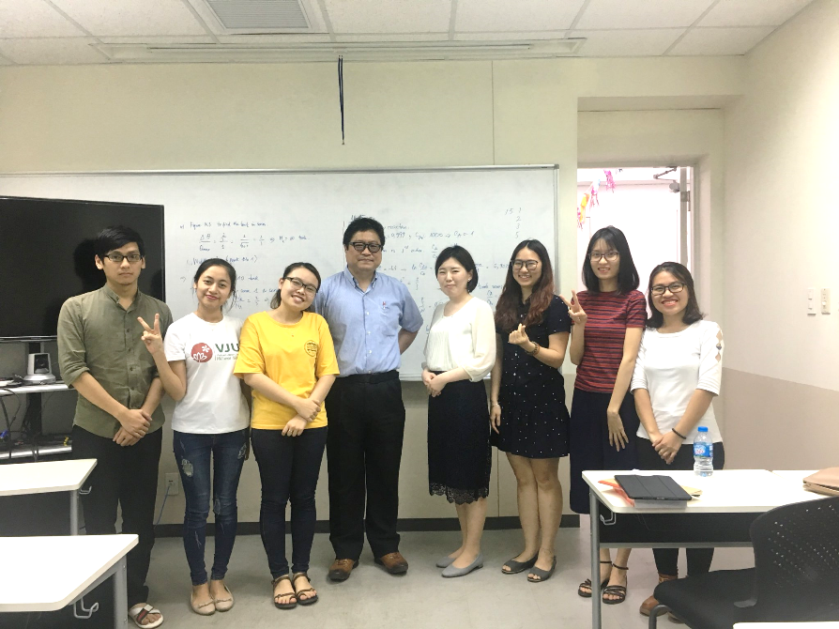
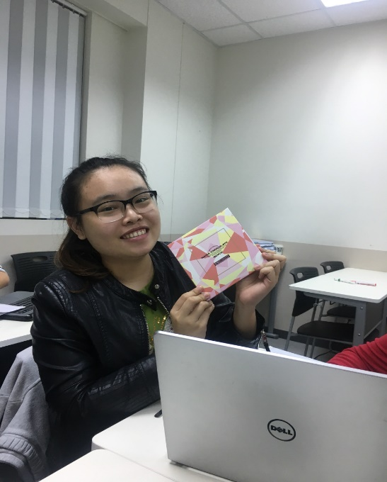
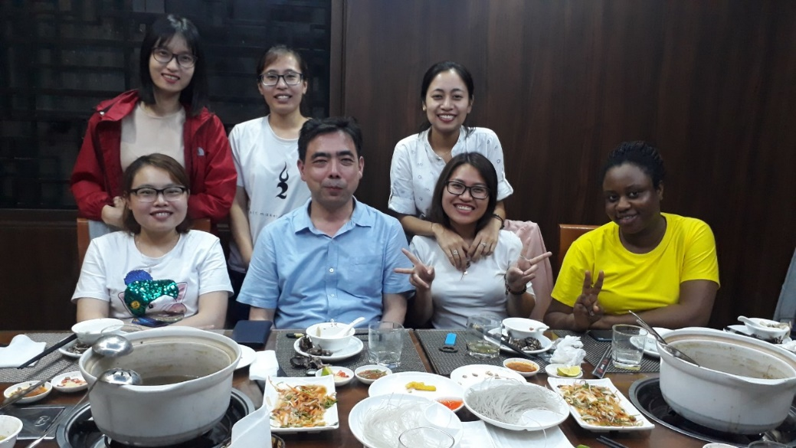
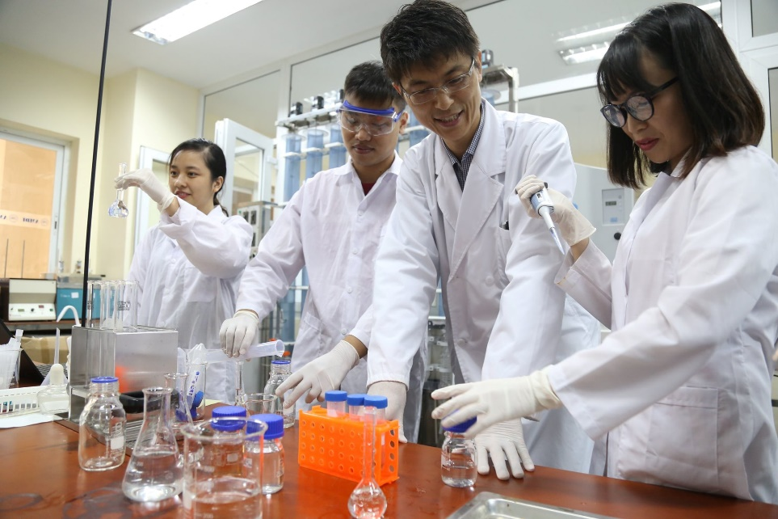
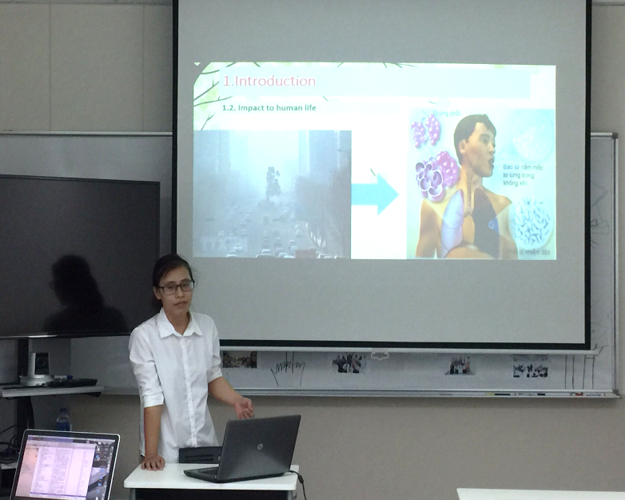
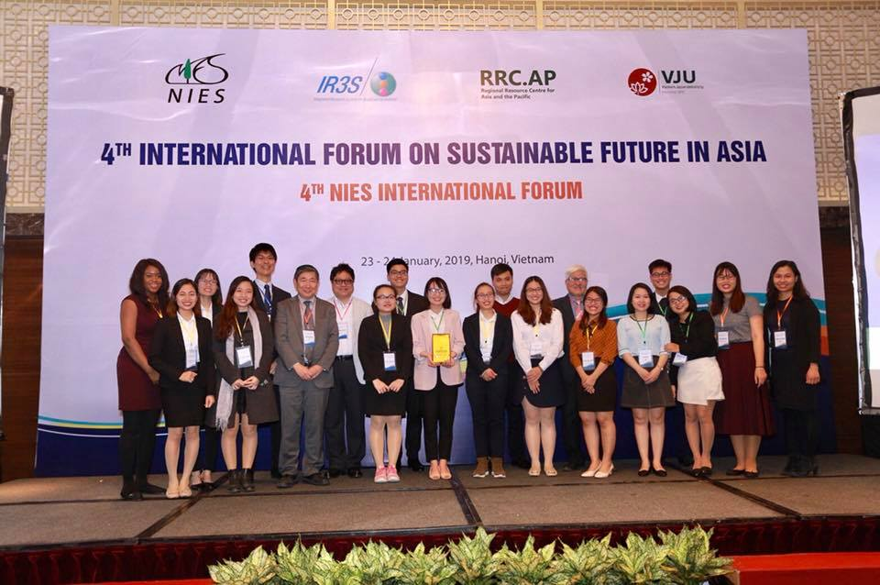
What will wait for you in MEE?

Slide 6
Cap and share all the memories
Find the relaxation in all the situation
AN AMAZING FIELDTRIP WILL WAIT FOR YOU
Dense academic schedule

Slide 7
SPECIAL FOOD
Thank you

